Slide 1
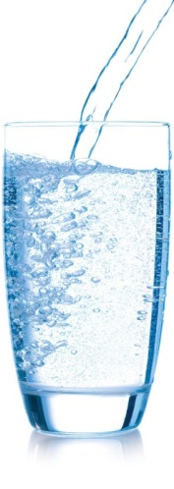

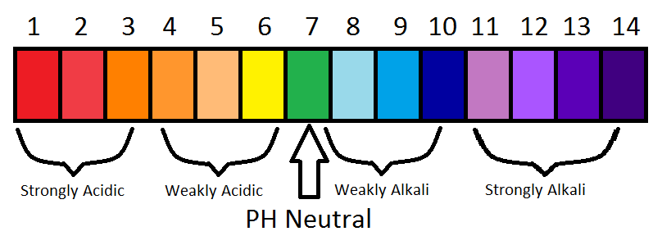
Neutralisation
23/2/15
23/2/15
Keywords: Neutralisation, base, acid, alkali
Starter: A bee sting is acid. What would you use to treat it and why? Chose from the pictures below

Slide 2
Starter: A bee sting is acid. What would you use to treat it and why? Chose from the pictures below
Use toothpaste or bicarbonate of soda as a weak
alkali neutralises a weak acid

Slide 3
LOb: Understand neutralisation reactions
Keywords: Neutralisation, base, acid, alkali
Learning Outcomes:
Describe how pH changes during neutralisation reactions
Explain useful examples of neutralisation reactions
Perform a neutralisation reaction
Did you know… it is believed that wasps stings are alkaline but actually they are just below neutral on the pH scale

Slide 4
Neutralisation: Means to cancel out
A chemical reaction happens when an acid and alkali
mix together forming a new substance.
A strong acid will neutralise a strong alkali and
vice versa

Slide 5
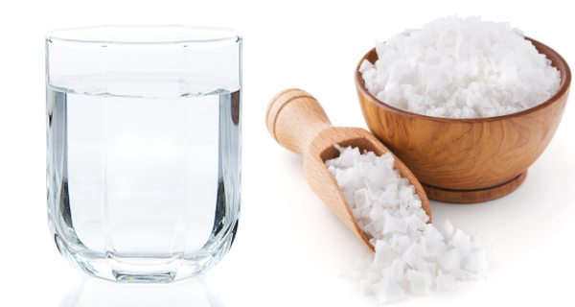
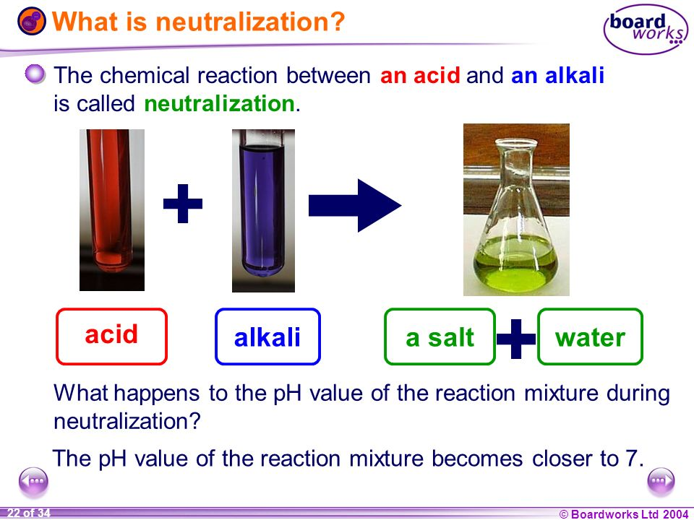
Neutralisation reaction

Slide 6
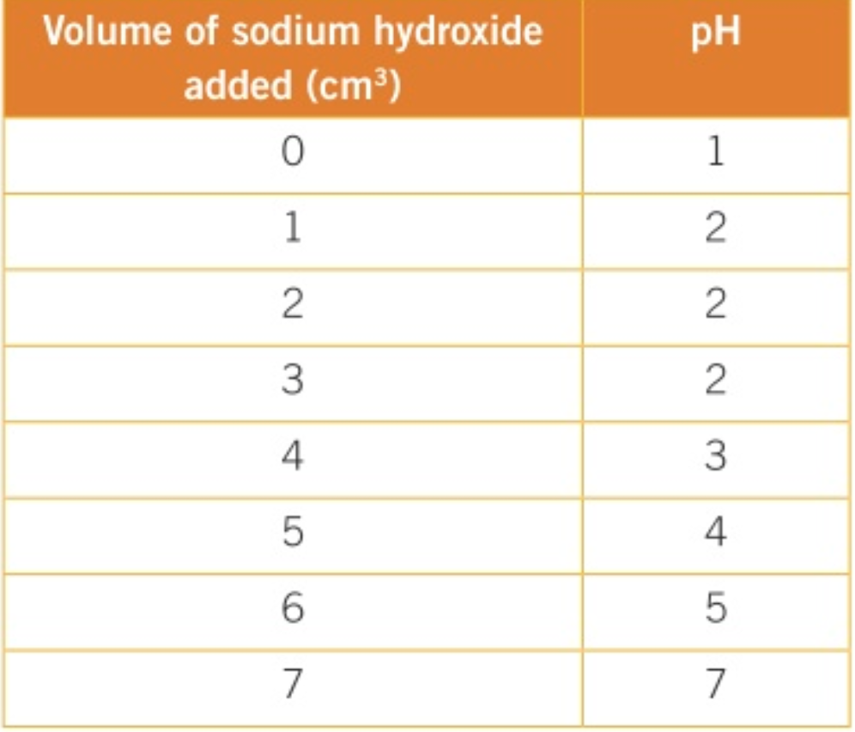
A beaker of Hydrochloric acid is below. Sodium hydroxide was added to the acid slowly 1 mL at a time
(mL)

Slide 7
Why is the beaker of acid coloured red?
What is the formula for Hydrochloric acid?
3. At what point was the hydrochloric acid neutralised?
4. How would the results have been different if a weaker alkali was used?
5. How would the results have been different if litmus paper was used instead during the test?

Slide 8
Why is the beaker of acid coloured red?
it has indicator in it the acid is red
2. What is the formula for Hydrochloric acid?
HCA NaOH HCl H₂SO₄
3. At what point was the hydrochloric acid neutralised?
4. How would the results have been different if a weaker alkali was used?
greater volume of alkali needed
pH would change much quicker
5. How would the results have been different if litmus paper was used instead during the test?

Slide 9
Why is the beaker of acid coloured red?
it has indicator in it the acid is red
2. What is the formula for Hydrochloric acid?
HCA NaOH HCl H₂SO₄
3. At what point was the hydrochloric acid neutralised?
4. How would the results have been different if a weaker alkali was used?
greater volume of alkali needed
pH would change much quicker
5. How would the results have been different if litmus paper was used instead during the test?
When 7cm³ of NaOH was added and it reached pH7
It would only have turned blue litmus paper red when it had got past pH7

Slide 10
LOb: Understand neutralisation reactions
Keywords: Neutralisation, base, acid, alkali
Learning Outcomes:
Describe how pH changes during neutralisation reactions
Explain useful examples of neutralisation reactions
Perform a neutralisation reaction
Did you know… it is believed that wasps stings are alkaline but actually they are just below neutral on the pH scale

Slide 11
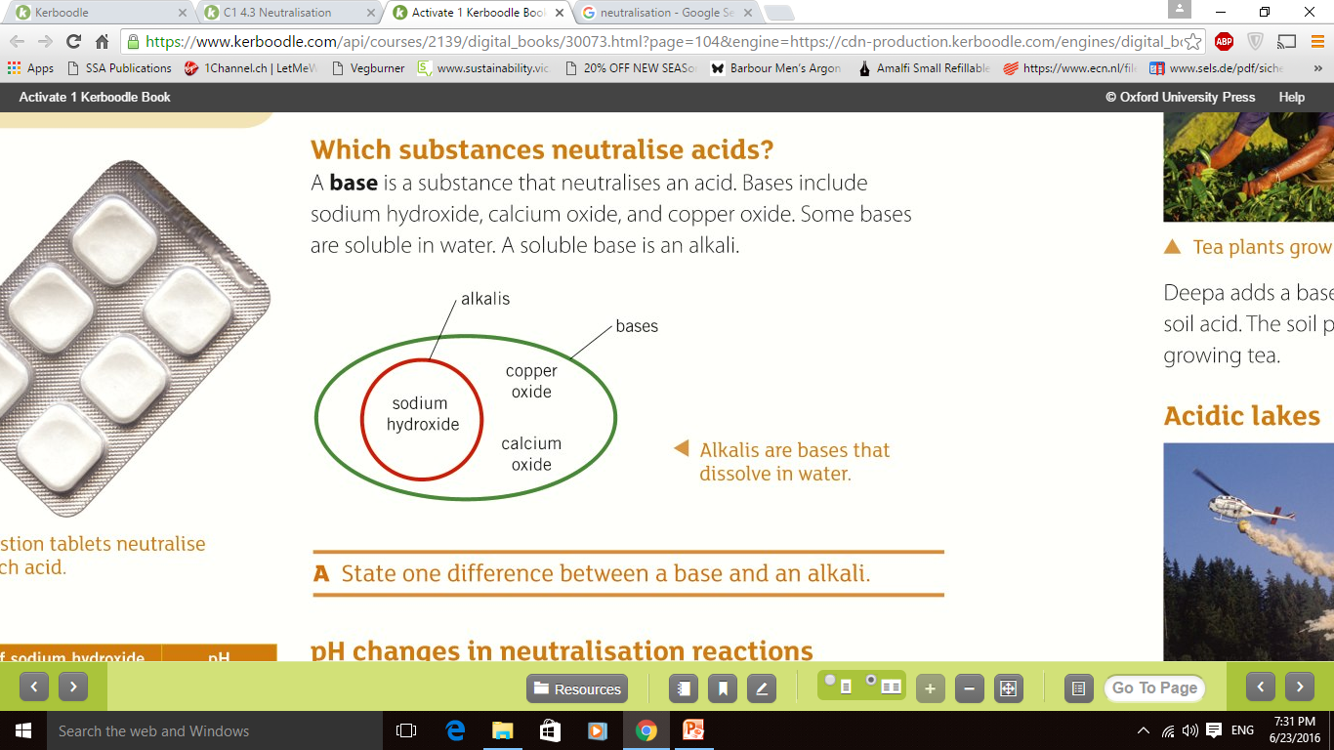
What is a base?
Notes:
https://www.youtube.com/watch?v=_cB2vSaalXg

Slide 12

Input: Listen out for how neutralisation is used in every day life. Make notes as you watch; you will need them later.
Notes:
https://youtu.be/RmnT9jwX4gQ?t=108

Slide 13
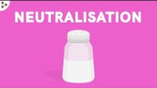

Slide 14


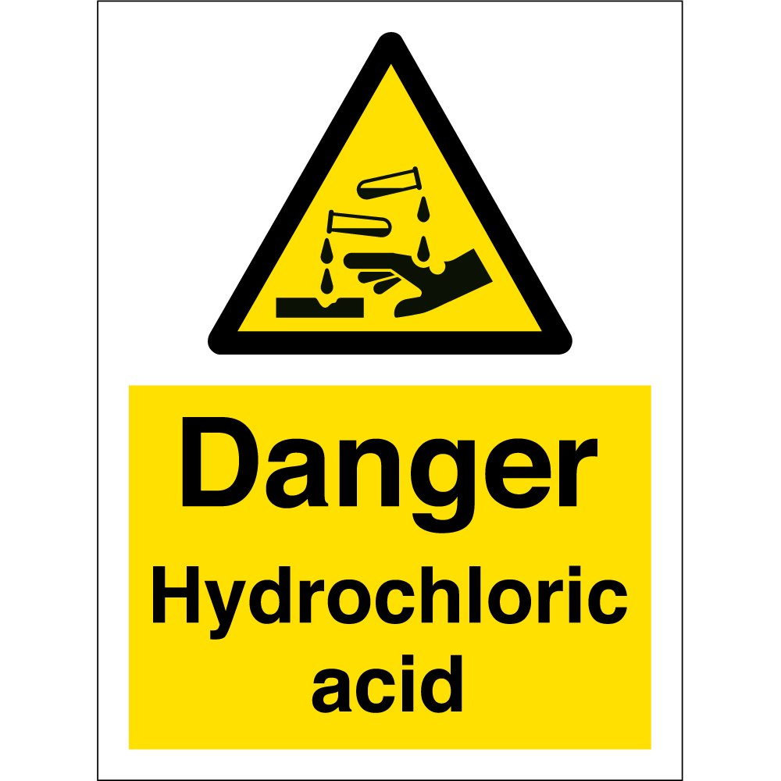

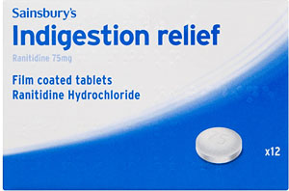


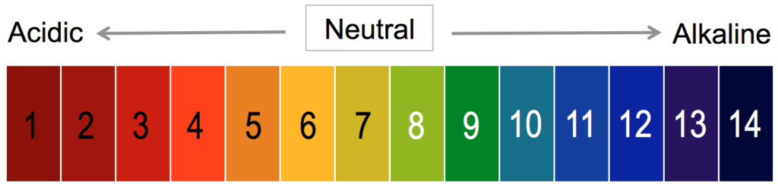
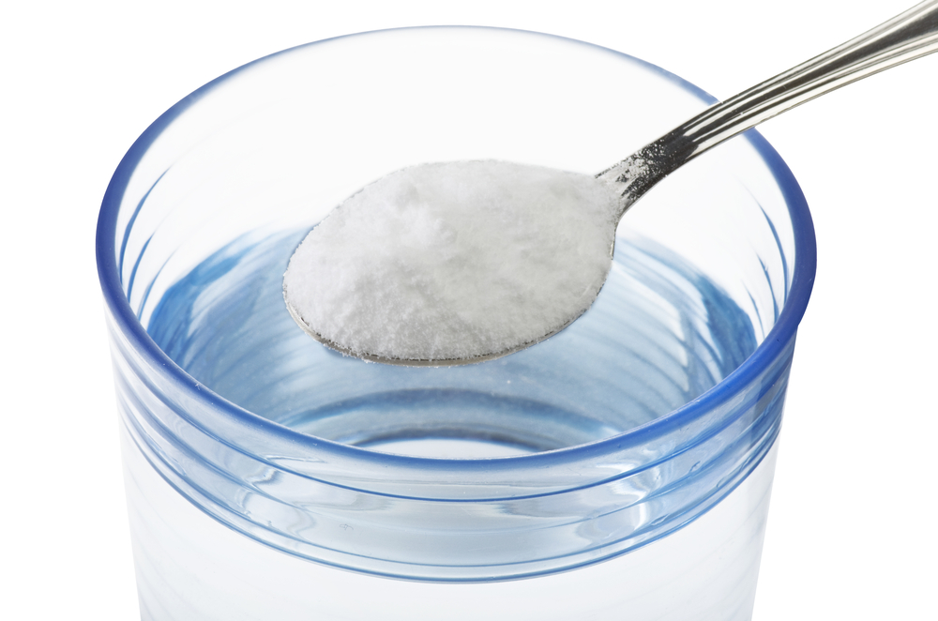
Activity: Use the words below to explain how we use neutralisation for indigestion
Neutralisation
Stomach acid
Bicarbonate of soda
Indigestion
Alkali
Salt + water

Slide 15
We have s________ acid to help digestion. The acid is called hydro________ a_____. When it gets too much it causes ___________. To stop this we need to neutralise the acid. We add bi_________ of soda tables which are an _________. This reacts with the acid to form ______ and _______ which are harmless. This process is called ________________

Slide 16
Review
We have stomach acid to help digestion. The acid is called hydrochloric acid. When it gets too much it causes indigestion. To stop this we need to neutralise the acid. We add bicarbonate of soda tables which are an alkali. This reacts with the acid to form salt and water which are harmless. This process is called neutralisation

Slide 17

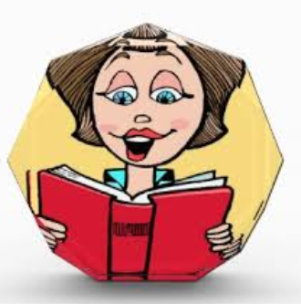
Review: Read out your answers

Slide 18
We have stomach acid to help digestion. When it gets too much we
need to calm it down. We can neutralise it by adding an alkali.
We add bicarbonate of soda indigestion tablets which causes a reaction
With the acid forming salt and water.

Slide 19

What would we use to neutralise?
Bee stings are ACIDIC
Bee stings are around pH3
Bicarbonate of soda (pH9)
Black Coffee (pH5)
Lemon Juice (pH2)
Water (pH7)
Notes:
So lets look at some of the uses of neutralisation, why is it important? How many of you have been stung by a bee? Did you put anything on it to stop it hurting? Looking at whats on the board, which of these things do you think would be the best to put on a bee sting?

Slide 20
Neutralisation
1. What colour is neutral on the pH scale?
2. If I had an acid of pH 1, what substance would neutralise it? Bleach (pH13)
3. If I had an alkali of pH 10, what acid would you use to neutralise it? Tomato Juice (pH4)
4. Which substance would neutralise lemon juice(pH 2)? Soapy Water (pH12)
Notes:
Tell them to look at the task on the bottom of the page

Slide 21
LOb: Understand neutralisation reactions
Keywords: Neutralisation, base, acid, alkali
Learning Outcomes:
Describe how pH changes during neutralisation reactions
Explain useful examples of neutralisation reactions
Perform a neutralisation reaction
Did you know… it is believed that wasps stings are alkaline but actually they are just below neutral on the pH scale

Slide 22
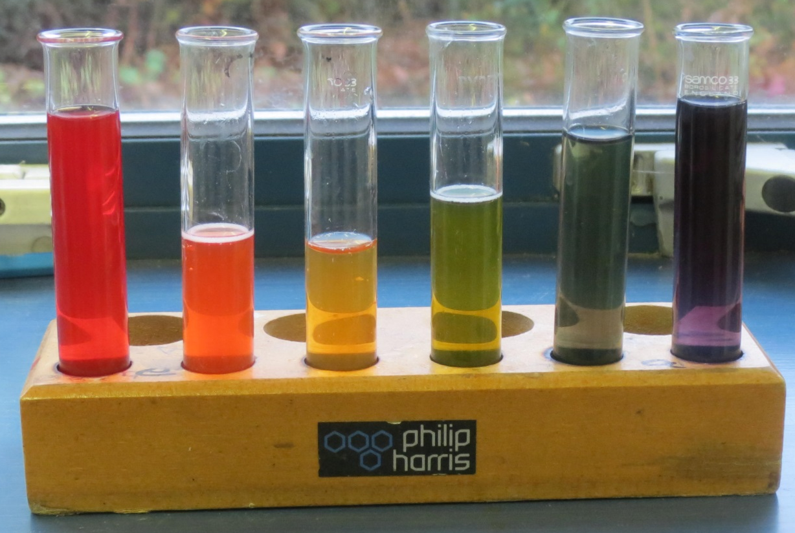
You have 10mins to create a test tube rainbow
Notes:
Your first task today is to create a test tube rainbow. Does anybody have any ideas on how they you might do this? Add different acids and alkalis to universal indicator to make the different colours.
It would be easy to do that! Instead, you’re going to have to try and make all the colours with only one acid and one alkali
Get into pairs, you have 25 mins to complete the experiment and the team with the best rainbow and who worked the best will be awarded 5 vivos.

Slide 23

AIM: To use your acid and alkali to create the best solution rainbow in the class

Slide 24

Equipment:
Spotting tile
Universal indicator
(Alkali)
(Acid)
pH scale
Measuring cylinder
Method
Place acid into the test tube
Place 2 drops of universal indicator in each test tube
The rest is for you to work out!
HINT: Try mixing the acid and alkali together

Slide 25
LOb: Understand neutralisation reactions
Keywords: Neutralisation, base, acid, alkali
Learning Outcomes:
Describe how pH changes during neutralisation reactions
Explain useful examples of neutralisation reactions
Perform a neutralisation reaction
Did you know… it is believed that wasps stings are alkaline but actually they are just below neutral on the pH scale

Slide 26

https://www.youtube.com/watch?v=UOUN2hXvn6Y

